Slide 1
Genetic Algorithm

Slide 2
Intuition behind Genetic Algorithms
“It is not the strongest of the species that survives, nor the most intelligent, but the one most responsive to change.”

Slide 3
Hypothetical Situation
You are head of a country, and in order to keep your city safe from bad things, you implement a policy like this:
You select all the good people, and ask them to extend their generation by having their children.
This repeats for a few generations.
You will notice that now you have an entire population of good people.
Firstly, we defined our initial population as our countrymen.
We defined a function to classify whether is a person is good or bad.
Then we selected good people for mating to produce their off-springs.
And finally, these off-springs replace the bad people from the population and this process repeats.
Basic Idea
Change the input (i.e. population) such that we get better output (i.e. better country).

Slide 4
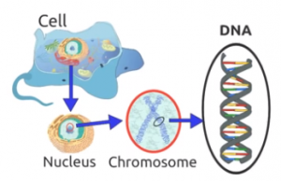
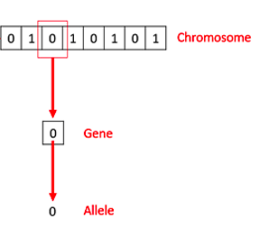
Biological Inspiration
Cells are the basic building block of all living things.
In each cell, there is the same set of chromosomes.
Chromosome are basically the strings of DNA.
These chromosomes are represented in binary as strings of 0’s and 1’s.

Slide 5
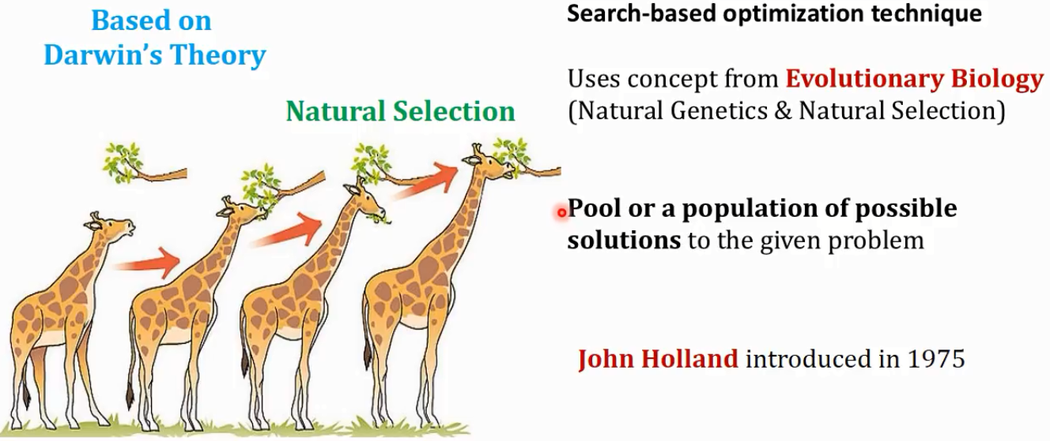
Genetic Algorithm

Slide 6
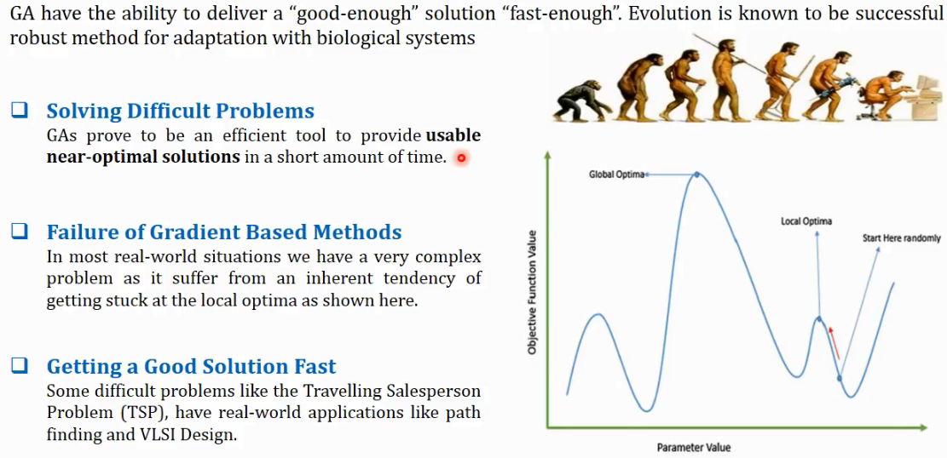
Motivation

Slide 7

Applications

Slide 8
AN OVERVIEW OF GENETIC ALGORITHMS
A genetic algorithm is a type of searching algorithm.
It searches a solution space for an optimal solution to a problem.
The key characteristic of the genetic algorithm is how the searching is done. The algorithm creates a “population” of possible solutions to the problem and lets them “evolve” over multiple generations to find better and better solutions.

Slide 9
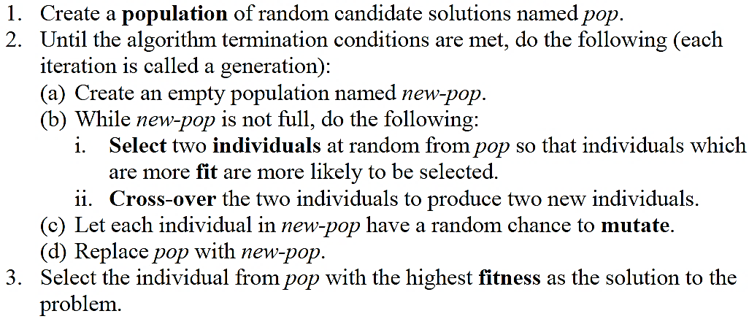

Slide 10
Population → collection of candidate solutions that we are considering during the course of the algorithm.
Over the generations of the algorithm, new members are “born” into the population, while others “die” out of the population.
A single solution in the population is referred to as an individual.
Fitness of an individual → a measure of how “good” the solution represented by the individual is. The better the solution, the higher the fitness – obviously, this is dependent on the problem to be solved.

Slide 11
The selection process is analogous to the survival of the fittest in the natural world.
Individuals are selected for “breeding” (or cross-over) based upon their fitness values – the fitter the individual, the more likely that individual will be able to reproduce.
The cross-over occurs by mingling the two solutions together to produce two new individuals.
During each generation, there is a small chance for each individual to mutate, which will change the individual in some small way.

Slide 12
Questions that need to be answered to use GA
How is an individual represented?
How is an individual’s fitness calculated?
How are individuals selected for breeding?
How are individuals crossed-over?
How are individuals mutated?
How big should the population be?
What are the “termination conditions”?

Slide 13
Population size is highly variable.
The larger the population, the more possible solutions there are, which means that there is more variation in the population. Variation means that it is more likely that good solutions will be created.
Therefore, the population should be as large as possible.
The limiting factor is, of course, the running time of the algorithm. The larger the population, the longer the algorithm takes to run.

Slide 14
An Application of GA
FUNCTION MAXIMIZATION
Find values for a collection of variables that will maximize a particular function of those variables.

Slide 15
Determine the variables that produce the maximum value for this function:

Slide 16
1. How is an individual represented?
Choose a size in bits for each variable, and then concatenate the four values together into a single bit string.
1101 0110 0111 1100
represents a solution where w = 13, x = 6, y = 7, and z = 12.

Slide 17
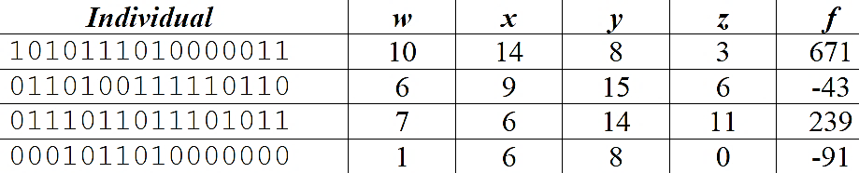
2. How is an individual’s fitness calculated?
The fitness function is a function that measures the value of the individual relative to the rest of the population.
Assume we have a population of 4 individuals:

Slide 18
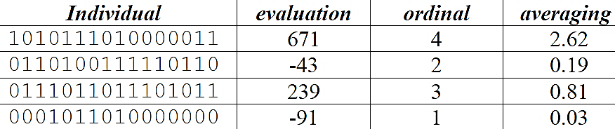
The fitness function can be chosen from many options. For example:
The individuals could be listed in order from lowest to highest evaluation function values, and an ordinal ranking applied. Or,
The fitness function could be the individual’s evaluation value divided by the average evaluation value².
The key is that the fitness of an individual should represent the value of the individual relative to the rest of the population, so that the best individual has the highest fitness.

Slide 19
3. How are individuals selected for breeding?
One possibility is to use the ordinal method for the fitness function, then calculate a probability of selection that is equal to the individual’s fitness value divided by the total fitness of all the individuals.
the first individual a 40% chance of being selected
the second a 20% chance
the third a 30% chance
the fourth a 10% chance
Clearly this is giving the better individuals more chances to be selected.

Slide 20
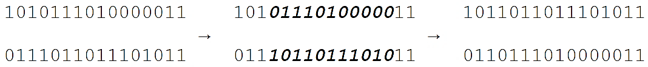
4. How are individuals crossed-over?
Typically two children are created from each set of parents.
Two locations are randomly chosen within the individual. These define corresponding substrings in each individual. The substrings are swapped between the two parent individuals, creating two new children.
1010 1110 1000 0011
0110 1001 1111 0110
0111 0110 1110 1011
0001 0110 1000 0000
The 4th and 14th bits are randomly selected to define the substring to be swapped, so the cross-over looks like this:
Thus, two new individuals are created.

Slide 21
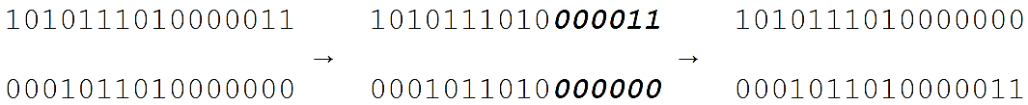
We should keep creating new individuals until we have created enough to replace the entire population.
In our example, we need one more cross-over.
Assume that the 1st and 4th individuals are selected this time.
Note that an individual may be selected multiple times for breeding, while other individuals might never be selected.
Further assume that the 11th and 16th bits are randomly selected for the cross-over point.
We would see a second cross-over like this:
So, our 2nd generation population is:
1011 0110 1110 1011
0110 1110 1000 0011
1010 1110 1000 0000
0001 0110 1000 0011

Slide 22
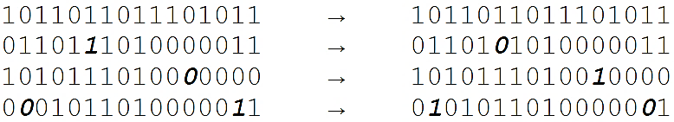
5. How are individuals mutated?
When using bit strings, the easiest way to implement the mutation is to allow every single bit in every individual a chance to mutate. This chance should be very small, since we don’t want to have individuals changing dramatically due to mutation.
Setting the percentage so that roughly 1 bit per individual will change on average is probably a reasonably good number.
The mutation will consist of having the bit “flip” – a 1 changes to a 0 and a 0 changes to a 1.

Slide 23
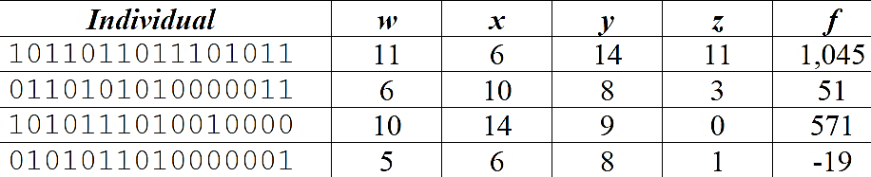
Wrapping Up

Slide 24
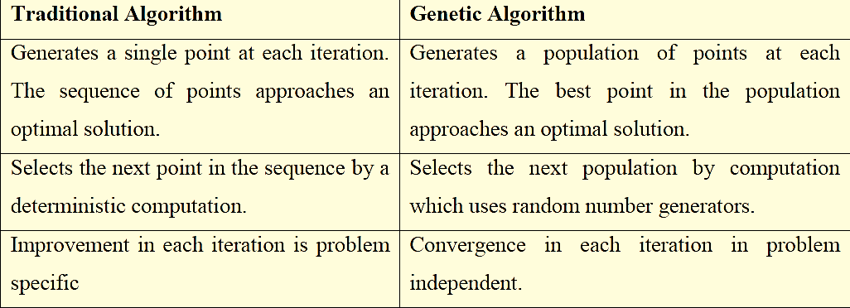
Difference between Traditional and Genetic Approach

Slide 25
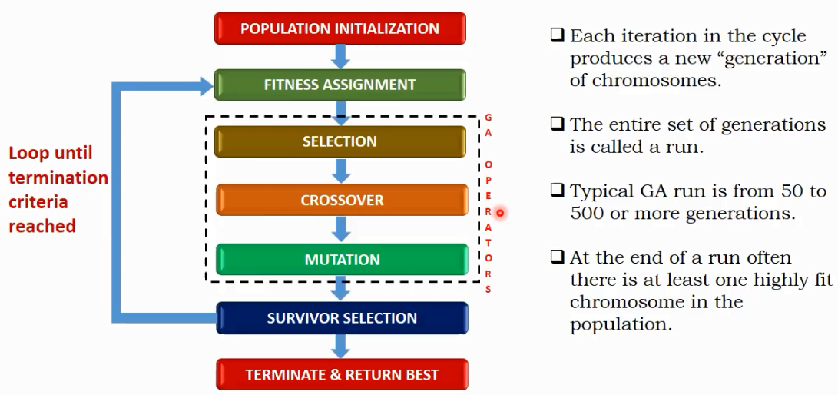
Basic Structure of Genetic Algorithm

Slide 26
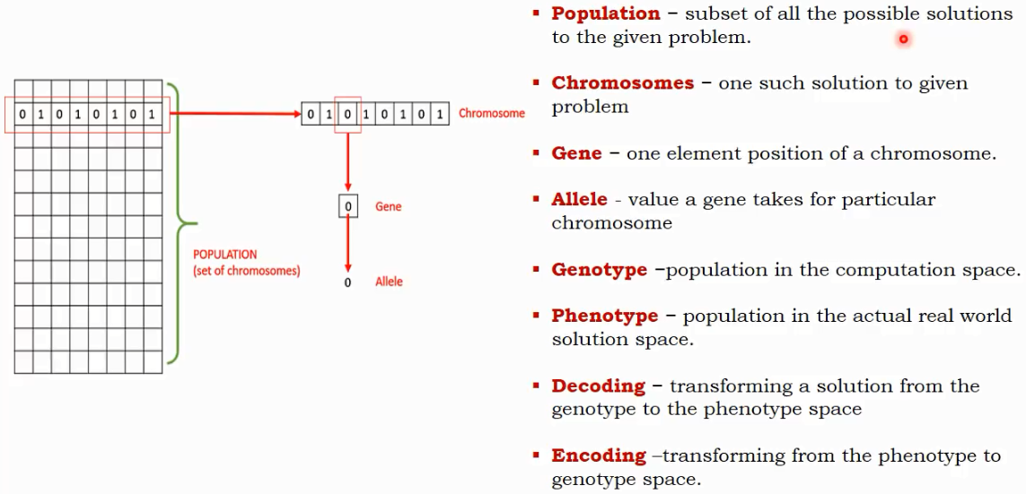
Basic Terminology of GA

Slide 27
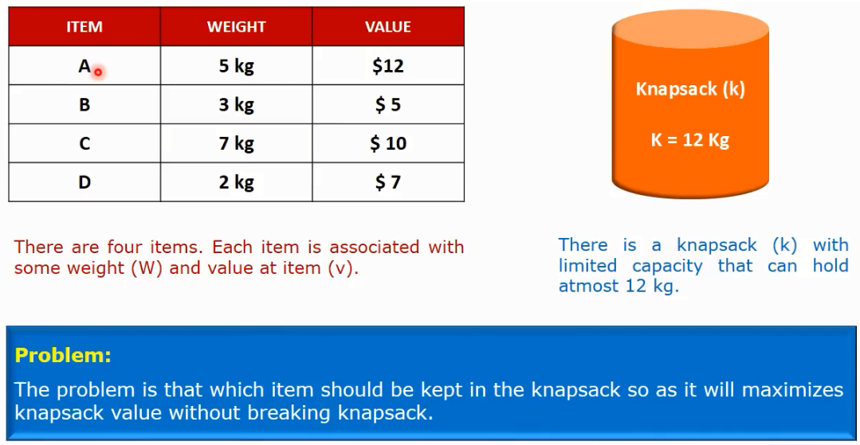
Knapsack Problem by using Genetic Algorithm

Slide 28
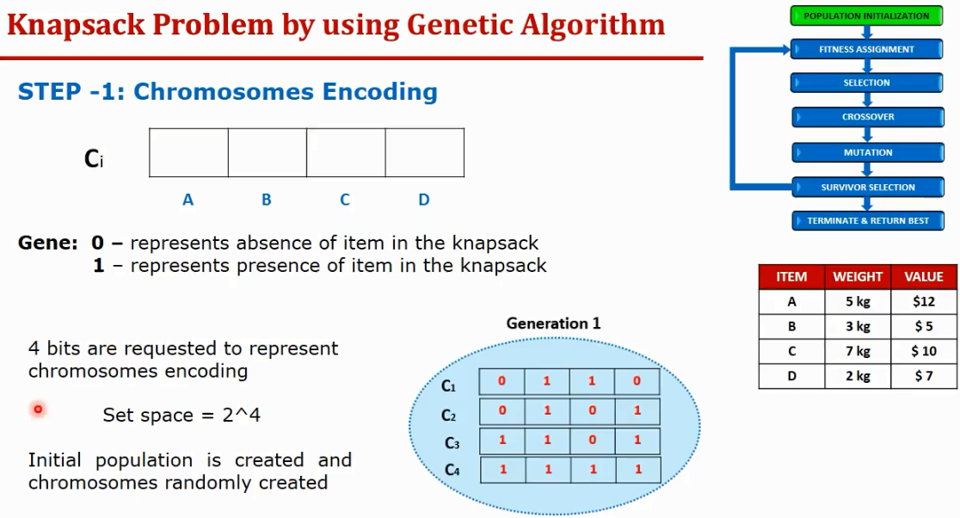

Slide 29
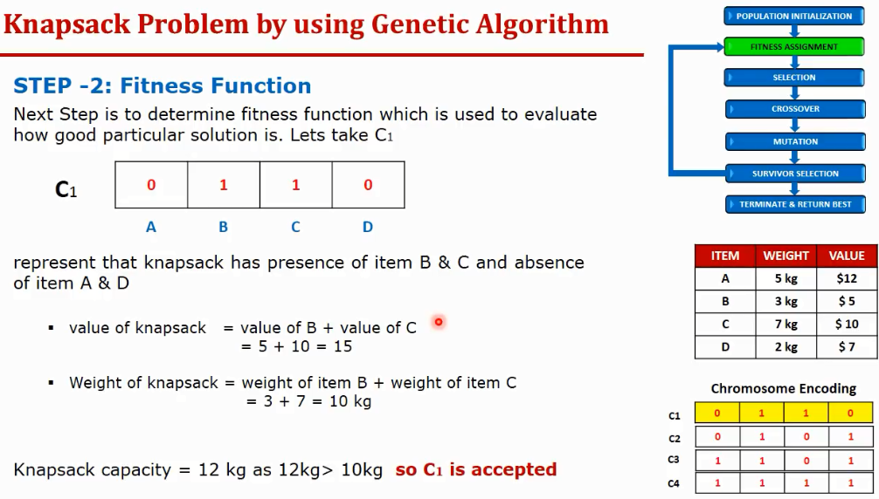

Slide 30
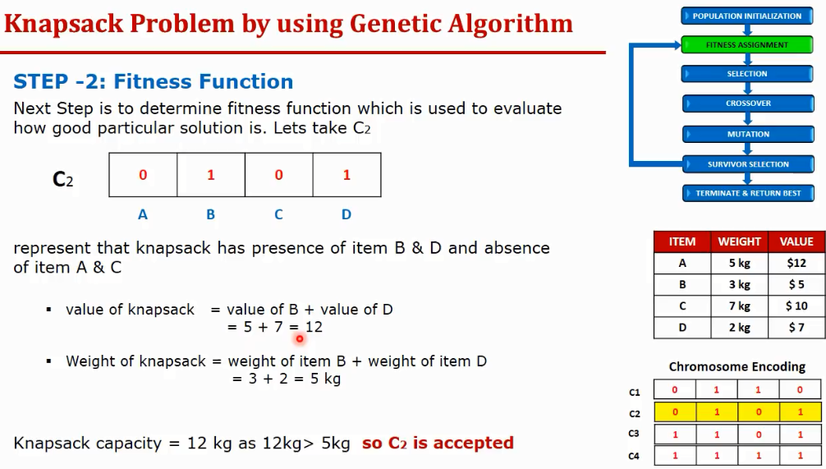

Slide 31
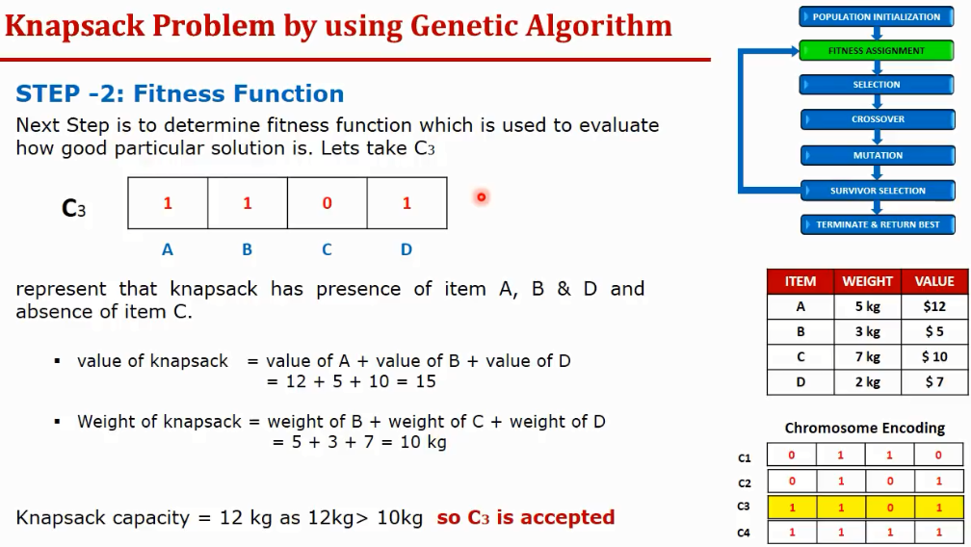

Slide 32
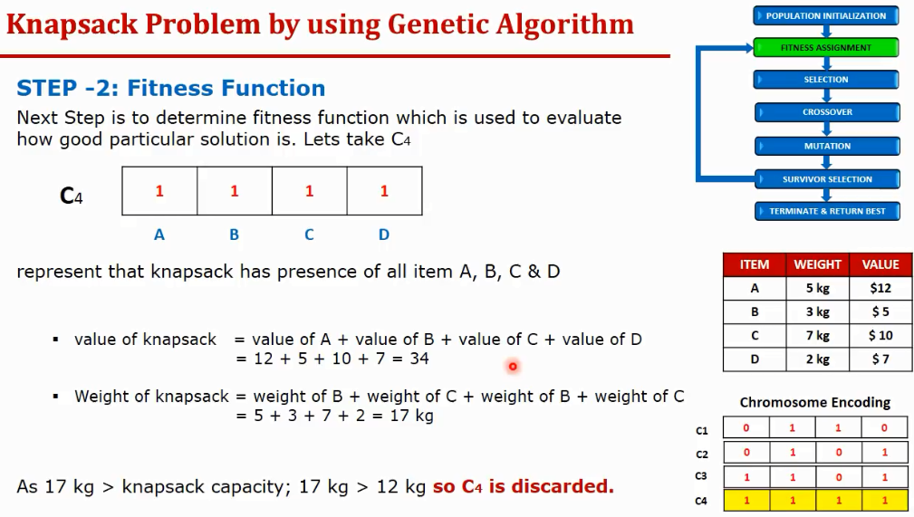

Slide 33
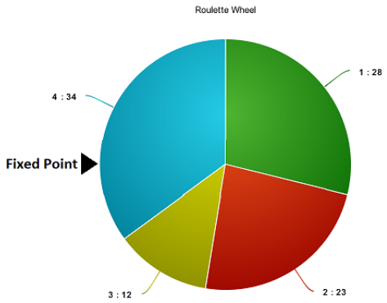
This wheel is rotated and the region of wheel which comes in front of the fixed point is chosen as the parent.
For the second parent, the same process is repeated.

Slide 34
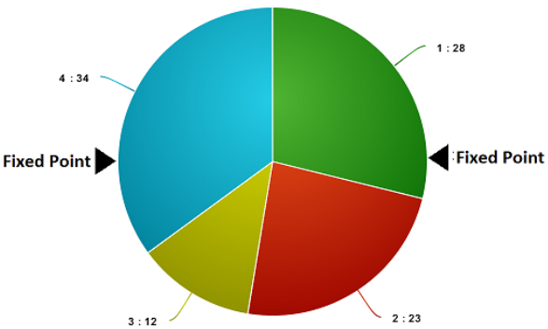
Sometimes we mark two fixed point as shown in the figure below.

Slide 35
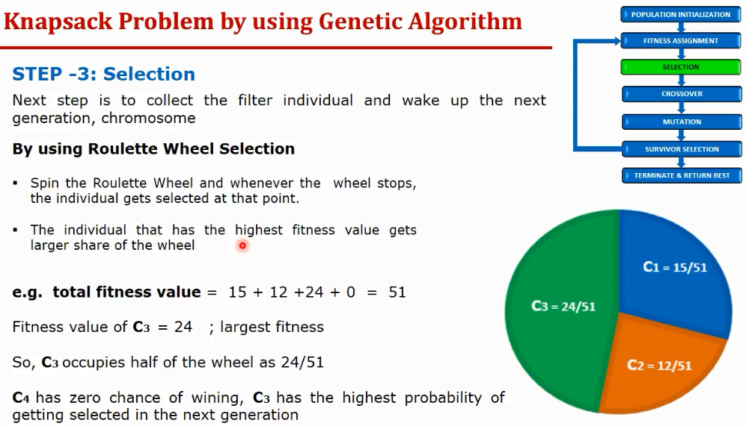

Slide 36
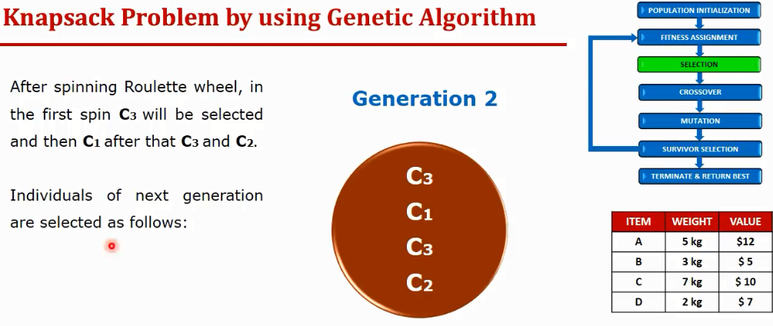

Slide 37
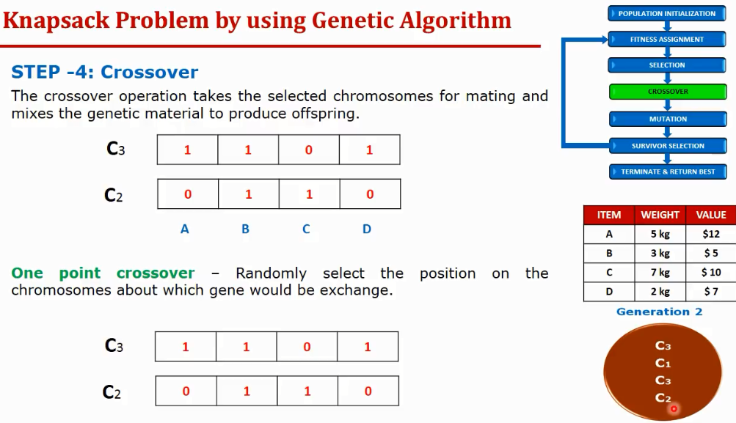
1

Slide 38
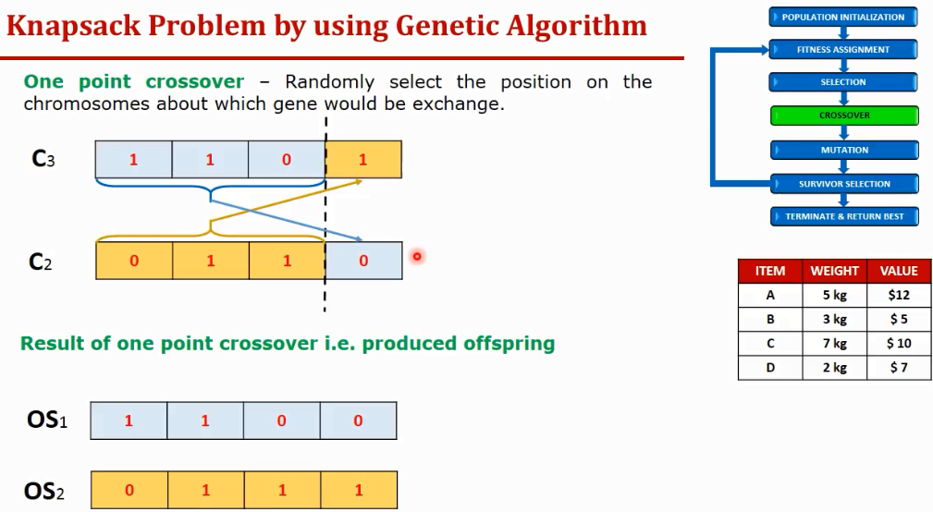

Slide 39
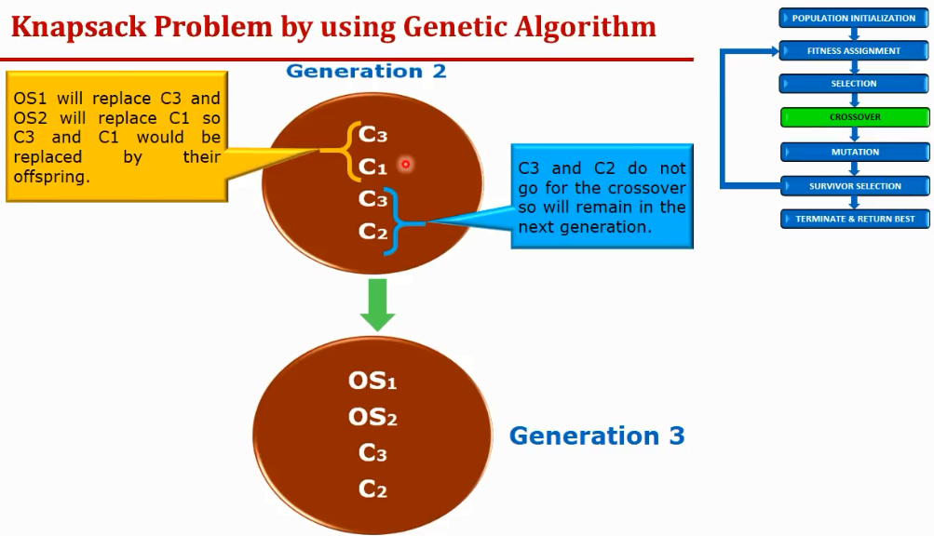

Slide 40
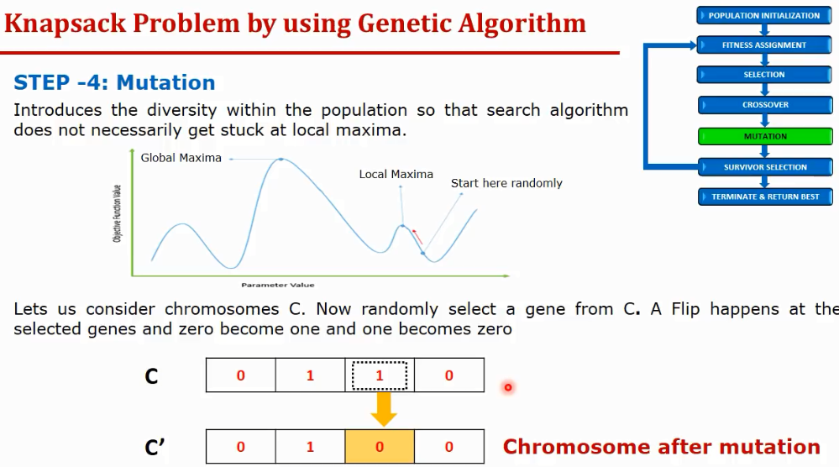

Slide 41
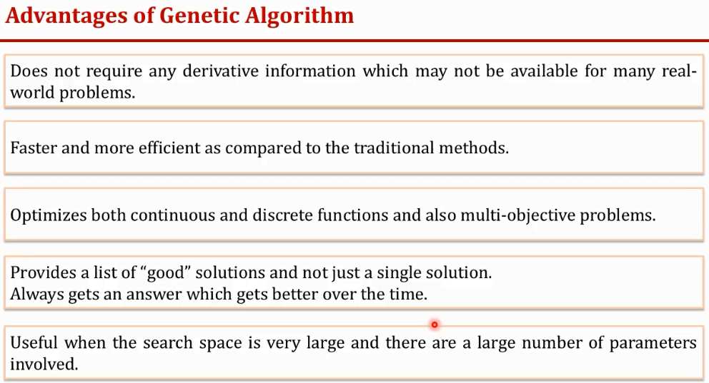

Slide 42
